Slide 1
Lake Thunderbird Watershed Alliance (LTWA)
Carrie Evenson, Member
Michele Loudenback, President

Slide 2
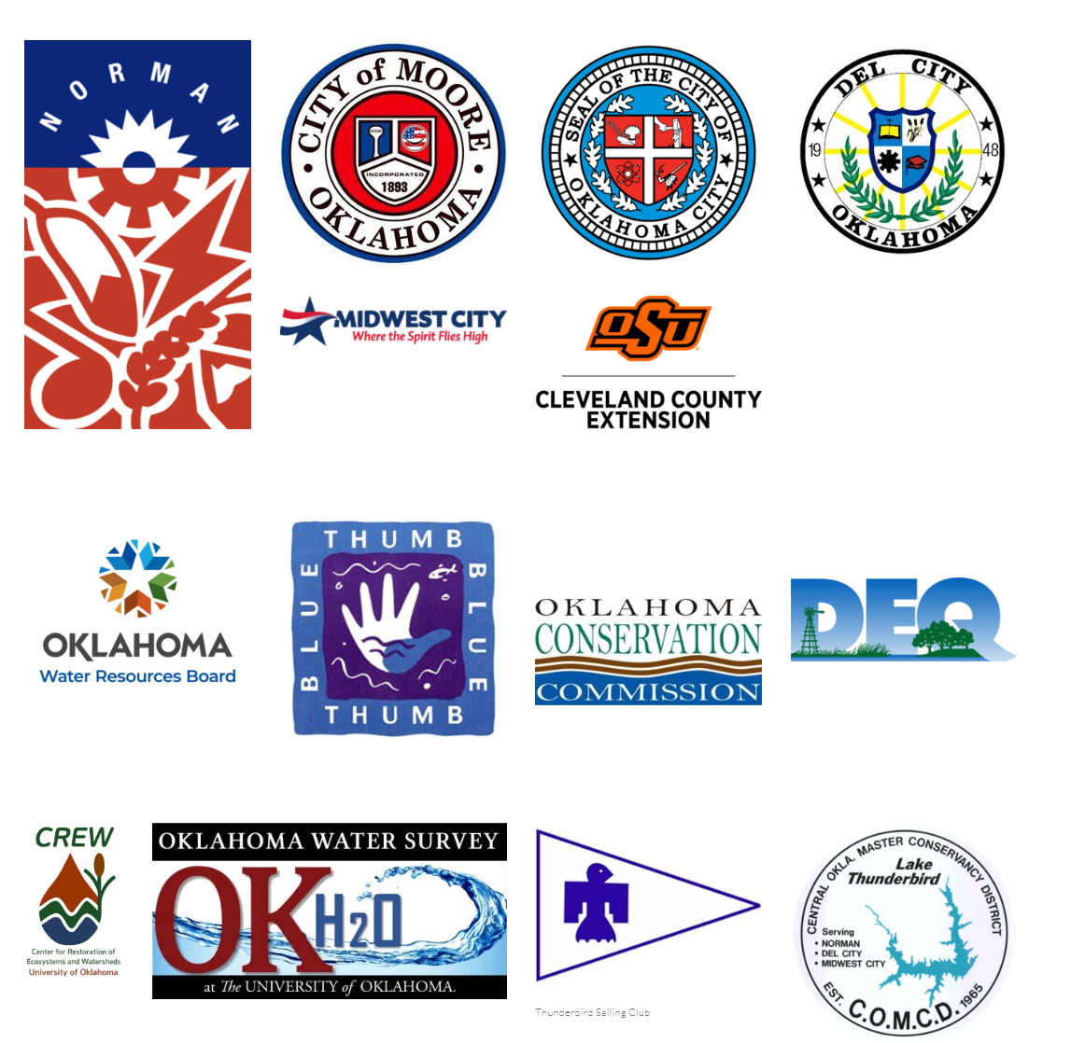
History of Organization
501(c)(3) founded in 2020
Coalition of diverse group of stakeholders within the Lake Thunderbird watershed
Members include:
Municipalities
State and County Agencies
Recreational Organizations
University Centers and Researchers
Homeowners, land owners and interested citizens
Educators
Others as identified

Slide 3
LTWA Board of Directors
Michele Loudenback, President
City of Norman Representative
Amanda Nairn, Vice President
COMCD Representative
Lance Phillips, Treasurer
Oklahoma Water Resources Board
Courtney Dekalb-Myers, Communications Officer
OSU Cooperative Extension Services
Mike Harlan
City of Moore Representative
Paul Streets
City of Midwest City Representative
Kraig Fryar
City of Del City Representative
Lynne Miller
Watershed Resident
Phil Moershel
Thunderbird Sailing Club
Kyle Arthur
Watershed Resident
Directors represent various categories, classifications and interests
Each of the following cities may appoint a staff representative to serve as a Director: Del City, Midwest City, Moore, Norman, Oklahoma City
COMCD has a fixed position on the Board
One Director represents recreational interests
Four Directors are at-large selected by the membership

Slide 4
Mission
To work collaboratively with residents, communities and other stakeholders to protect the water quality and quantity of Lake Thunderbird
To serve as a clearinghouse for information about Lake Thunderbird including implementation projects, research and outreach material

Slide 5
Goals and Objectives
Raise awareness and educate the public on the importance of pollution prevention and watershed stewardship
Target efforts to improve water quality
Track implementation of Best Management Practices
Investigate new technology and watershed management support decision tools

Slide 6
Work in the Watershed to Date
Education and Outreach Committee Established
Goal: Distribute information on activities within the watershed and ways in which stakeholders can protect water quality
Activities Conducted
Established an annual “Love Your Lake Week” during Lakes Appreciation Month in July
Host annual clean-up events in various locations throughout the watershed
Held workshops on Low-Impact Landscapes for Your Lake
Provide experts to speak to classes, groups, and organizations on various topics
Currently seeking landowners to host watershed cleanup events

Slide 7
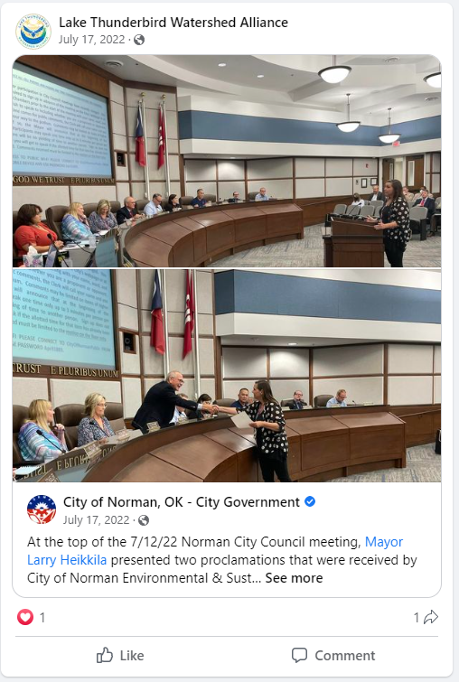
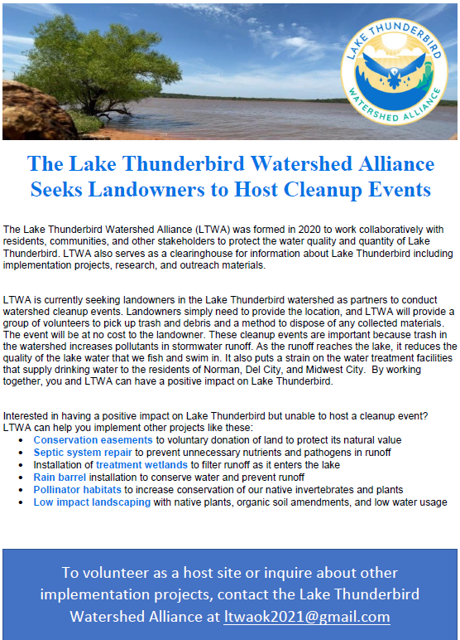

Slide 8
Current Programs to Be Expanded
Public Information
Create additional handbills, flyers, brochures and other print materials
Focus on specific audiences and pollutants
Identify and use of additional advertising venues beyond social media
Distribute watershed-scale surveys
Workshops and Events
Host additional workshops on watershed topics
Expand workshops to include half- and full-day events
Partner with landowners and organizations to conduct watershed clean-up events (locations, waterways)

Slide 9
Programs Under Development
Small scale BMP installation
Rain barrels, pollinator gardens, rain gardens, low impact landscaping
Urban detention pond retrofit for water quality improvement
Site identified and landowner support obtained
Funding source currently being researched
Cooperative Watershed Management Program
Environmental Water Resources Projects
Septic system maintenance and repair program
Opportunity to be part of new statewide program
Partnership with state agencies in process

Slide 10
Donations
Able to accept donations from individuals and groups as a non-profit
No other source of revenue currently
Potential uses for donations
Match money for grant applications
Project implementation funds
Public education and outreach materials and supplies
Expanded workshops and events

Slide 11
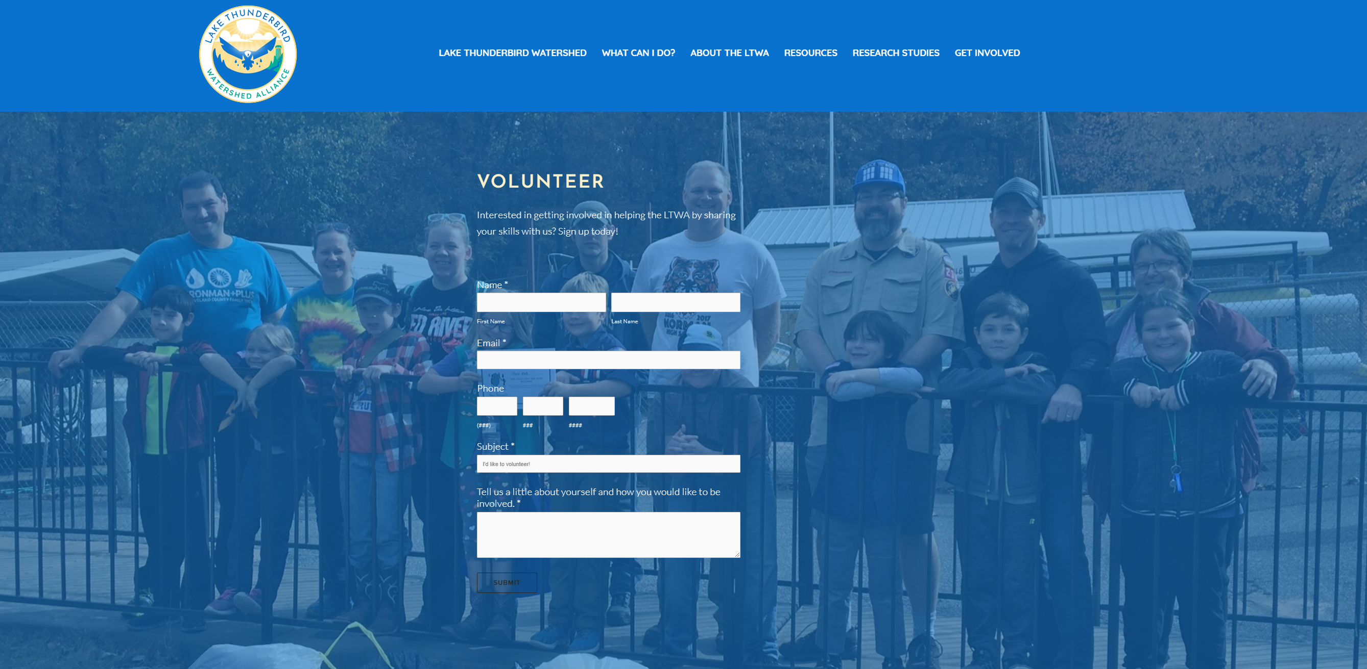
Questions and Discussion
www.ltwaok.org

