Slide 1
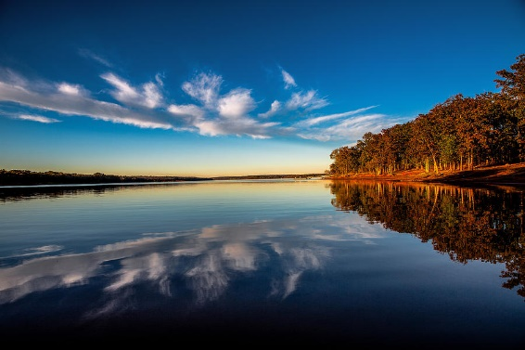
Lake Thunderbird Water Quality Trends
June 3, 2022

Slide 2
Exploratory Data Analysis
Affects Study Design
Is the data suitable for trends analysis
Adequate data
Both period of record and timestep
Period of Record
Hydrologic Variation
Climatological Variation
Physical Variation
Timestep
Data intermittency issues (short term interruptions)
Inadequate seasonality
Data gaps (long-term interruptions)
Parameter Selection

Slide 3
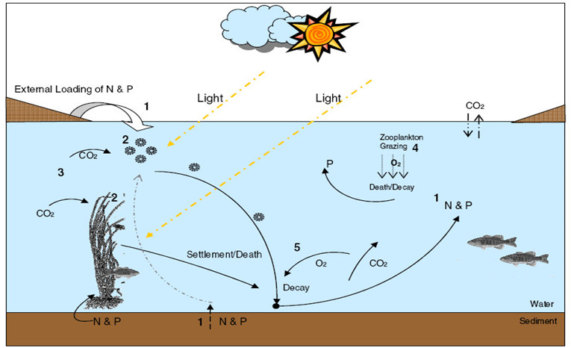
Parameter Selection
Watershed characteristics
Stressor variables
Eutrophication
Sedimentation
Response variables
Water Clarity
Transparency (i.e., Available Light)
Biologic Response (algal chlorophyll and pheophytin, plankton community dynamics)
Nutrients (N and P) enter the lake through external loading from the surrounding watershed and internal recycling processes
Nutrients and light stimulate the growth of phytoplankton and macrophytes (aquatic plants)
Aquatic plants consume carbon dioxide and the increase the pH of the lake
Zooplankton (aquatic invertebrates) graze on the phytoplankton population
Aquatic plants break down and or die, consume oxygen as part of decomposition, and recycle ammonia, phosphorus, and carbon dioxide into the water and the sediments

Slide 4
Parameter Selection
Analyzed Surface Parameters | Unit | Indicator Type
Turbidity | NTU | Sedimentation stressor and response
Secchi Disk Depth | cm | Eutrophication stressor and response
Total Alkalinity | mg/L | Watershed geology
Total Hardness | mg/L | Watershed geology
Chlorophyll a | µg/L | Eutrophication stressor response
Pheophytin-a | µg/L | Eutrophication stressor response
Ammonia as N | mg/L | Eutrophication stressor
Inorganic Nitrogen as N | mg/L | Eutrophication stressor
Total Nitrogen as N | mg/L | Eutrophication stressor
Total Phosphorous as P | mg/L | Eutrophication stressor

Slide 5
Exploratory Data Analysis
Spatial Analysis
Is the lake adequately represented both ecologically and hydrologically?
Can stations be aggregated?
Data Analysis
What is the condition of the data
Look at both distribution and shape
Affects statistical analysis and interpretation

Slide 6
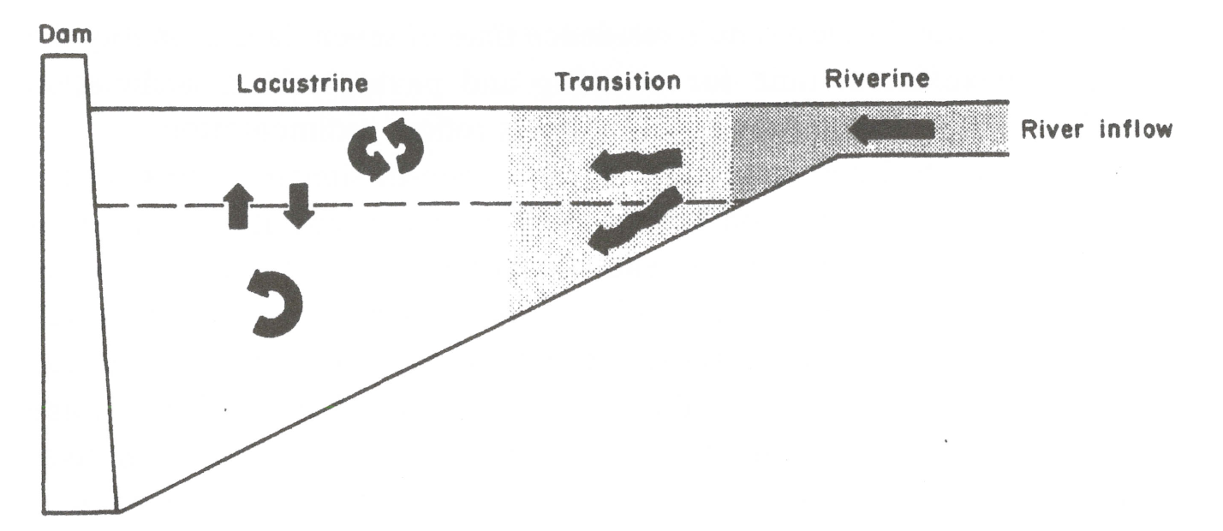
Reservoir Ecological Zones

Slide 7
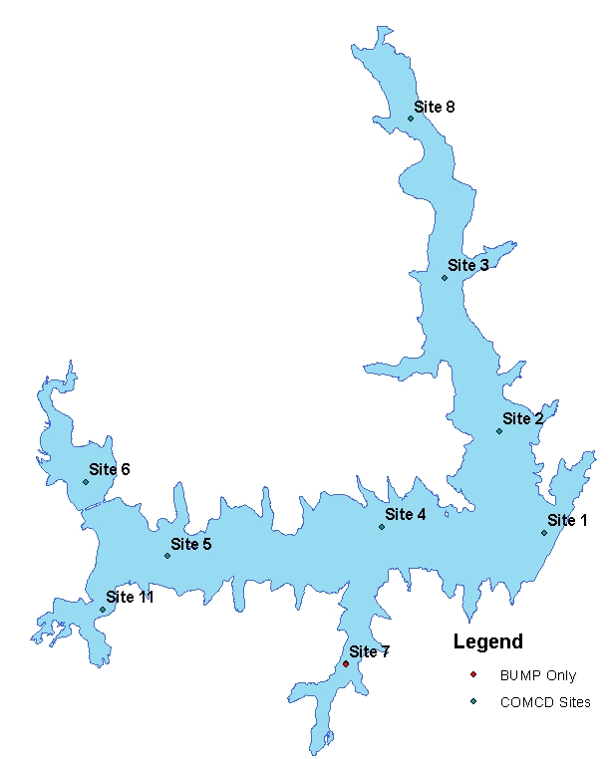
Monitoring ID | Name | Ecological Zone Assignment
520810000020-01 | Sta 1 | Lacustrine
520810000020-02 | Sta 2 | Lacustrine
520810000020-04 | Sta 4 | Lacustrine
520810000020-12 | Sta 12 | Lacustrine
520810000020-03 | Sta 3 | Hog Creek Transition
520810000020-08 | Sta 8 | Hog Creek Riverine
520810000020-05 | Sta 5 | Little River Transition
520810000020-07 | Sta 7 | Little River Transition
520810000020-06 | Sta 6 | Little River Riverine?
520810000020-11 | Sta 11 | Dave Blue Creek Riverine

Slide 8
Station | Ecological Zone Assignment
Stations 1, 2, 4 | Lacustrine
Station 3 | Hog Creek Transition
Station 8 | Hog Creek Riverine
Stations 5, 7 | Little River Transition
Station 6 | Little River Riverine
Station 11 | Dave Blue Creek Riverine

Slide 9
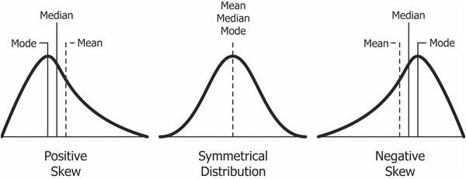
Data Analysis – Distribution and Shape

Slide 10
Data Analysis – Trends
Regression
Most commonly used in controlled designs
Assumes normal distribution, data independence, equal variance
Seasonal Kendall
Utility and bias not reliant on assumptions
Adjusts data for and test results for user-defined seasonal effects
Confidence Level and Trend Likelihood
Confidence Level | Trend Likelihood
<80% | Unlikely
80% to <90% | Indeterminant
90% to <95% | Likely
95% to <99% | Very Likely
99% and greater | Highly Likely

Slide 11
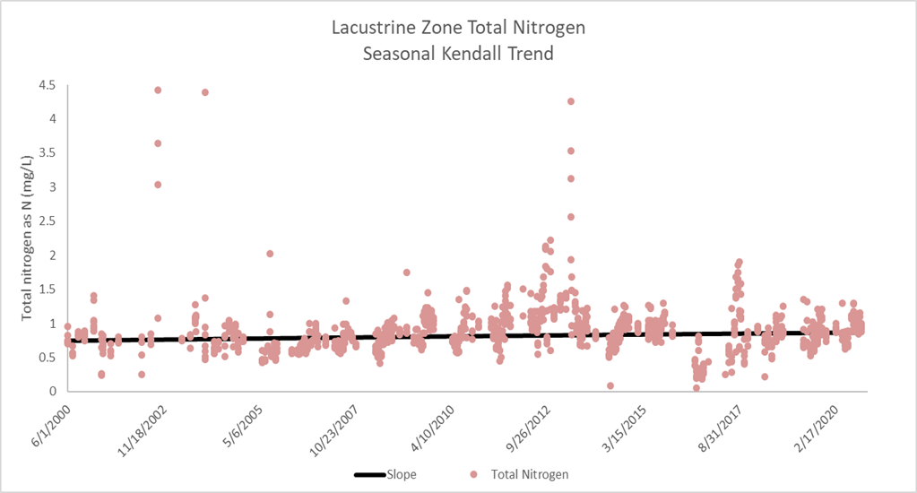
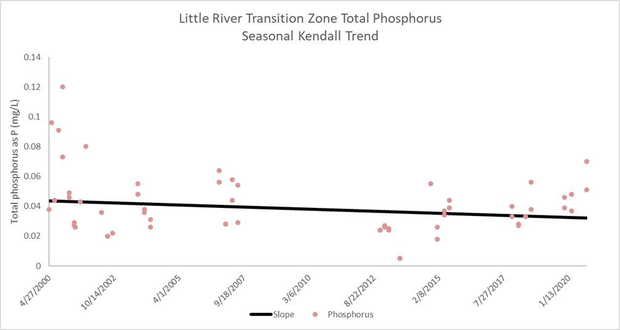
Trend Summary—Nutrients
Nutrients
Know that both TP and TN are high in the reservoir
Generally both showed no significant trend
For TN, showed a likely increasing trend in lacustrine
For TP, showed a likely decreasing trend in Little River Transition

Slide 12
Trend Summary—Clarity and Transparency
Ecological Zone |  | 2000 | 2020 | Trend Likelihood for Turbidity | slope (NTU/L*yr ⁻¹)
Lacustrine |  | 8.9 | 8.3 | Unlikely | -0.02
Transition | Little River | 14.9 | 14.9 | Unlikely | 0.00
 | Hog Creek | 12.7 | 11.0 | Indeterminant | -0.07
Riverine | Little River | 44.6 | 53.7 | Indeterminant | 0.45
Riverine | Hog Creek | 32.5 | 20 | Highly Likely to decrease | -1.00
Dave Blue Creek |  | 45 | 32.5 | Likely to decrease | -1.11
Ecological Zone |  | 2000 | 2020 | Trend Likelihood for Secchi Disc | slope (cm/L*yr⁻¹)
Lacustrine |  | 76.7 | 64.2 | Highly Likely | -0.63
Transition | Little River | 54.9 | 43.7 | Highly | -0.35
 | Hog Creek | 59.1 | 50.2 | Highly | -0.45
Riverine | Little River | 21.4 | 16.3 | Highly | -0.35
Riverine | Hog Creek | 29.9 | 31.8 | Unlikely | 0.12
Dave Blue Creek |  | 24.9 | 23.4 | Unlikely | -0.12

Slide 13
Trend Summary—Chlorophyll and Pheophytin
Ecological Zone |  | 2000 | 2020 | Trend Likelihood for Chlorophyll | slope (µg/L*yr⁻¹)
Lacustrine |  | 11.6 | 20.8 | Highly | 0.45
Transition | Little River | 12.8 | 25.7 | Highly | 0.64
 | Hog Creek | 12.0 | 24.3 | Highly | 0.60
Riverine | Little River | 19.0 | 32.7 | Highly | 0.67
Riverine | Hog Creek | 28.3 | 21.3 | Very | -0.5
Dave Blue Creek |  | 39 | 26.3 | Highly | -1.12
Ecological Zone |  | Trend Likelihood for Pheophytin
Lacustrine |  | Highly
Transition | Little River | Highly
 | Hog Creek | Highly
Riverine | Little River | Highly
Riverine | Hog Creek | Very
Dave Blue Creek |  | Highly

Slide 14
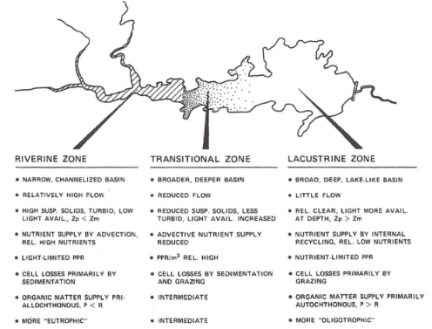
Reservoir Ecological Model
Following a longitudinal gradient
Nutrient Stressors
higher in riverine to lower in lacustrine
Source in upper end is watershed
Source in lower end is internal cycling
Turbidity
Upper end has high TSS upper end and is Light-limited
Lower end is clear with no light limiting
Response
Upper end mostly tending eutrophic
Become more oligotrophic toward lower end
High transparency

Slide 15
Thunderbird Attributes
Nutrients are at excessive levels throughout the reservoir
Are showing some decrease in the Little River transition zone
Need to understand nutrient entrainment and recycling better
Turbidity generally becomes lower as move through the lake
This is generally in line with the attribute model
Turbidity impairment mostly result of suspended solids in riverine zones of lake
Decreasing inorganic solids (turbidity) in the Hog Creek and Dave Blue Creek riverine zones suggest significant land use changes
Cultural eutrophication continues to be an ongoing and worsening process throughout the reservoir
Chlorophyll-a is increasing significantly in lacustrine, transition and Little River
As a corollary, transparency is significantly decreasing
Additionally, increasing pheophytin is indicative of continual algal die-offs
Conversely, have a significant decrease in chlorophyll-a in Hog and Dave Blue Creek but still considered hyper-eutrophic
Transparency shows a leveling in these areas, as well

Slide 16
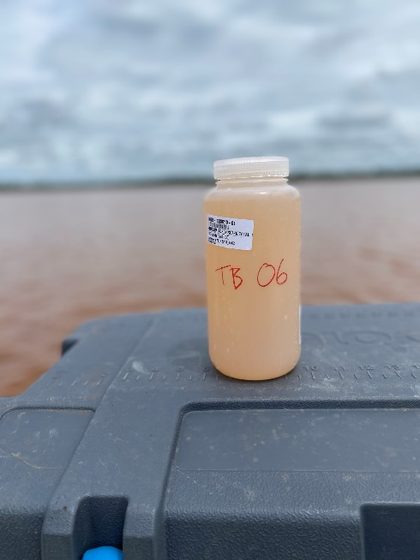
Recommendations
External vs Internal nutrient sources
Determine links between land use features and external load
Long-term trend analysis requires consistency
Prioritize Stations, parameters, sample frequency
Laboratory methods (detection limits)

Slide 17
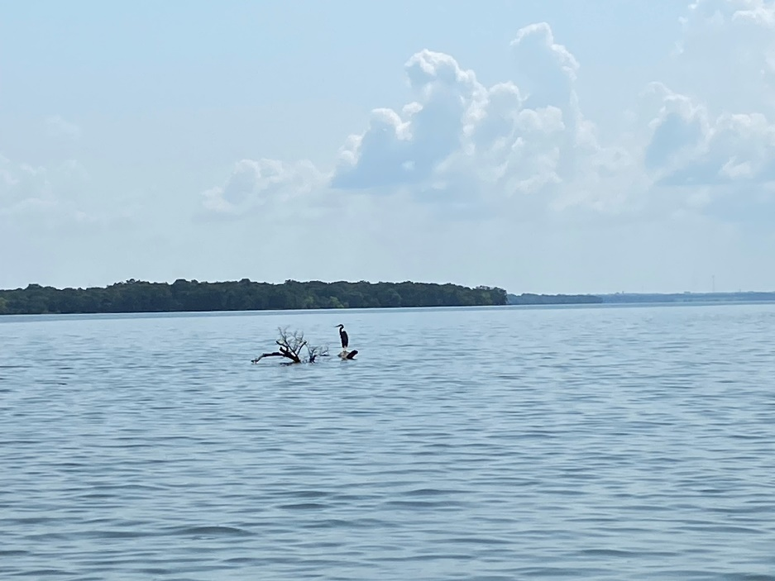
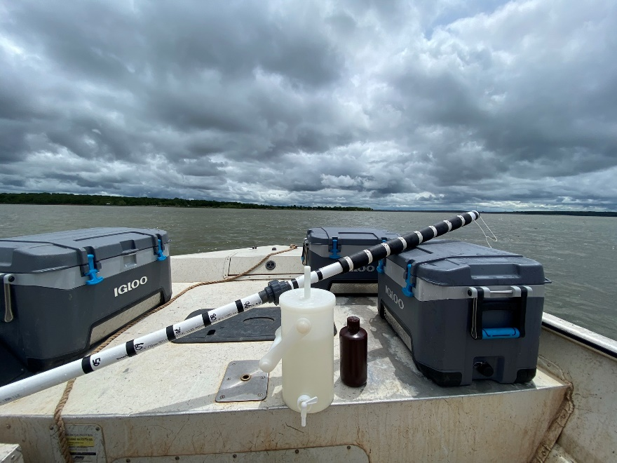
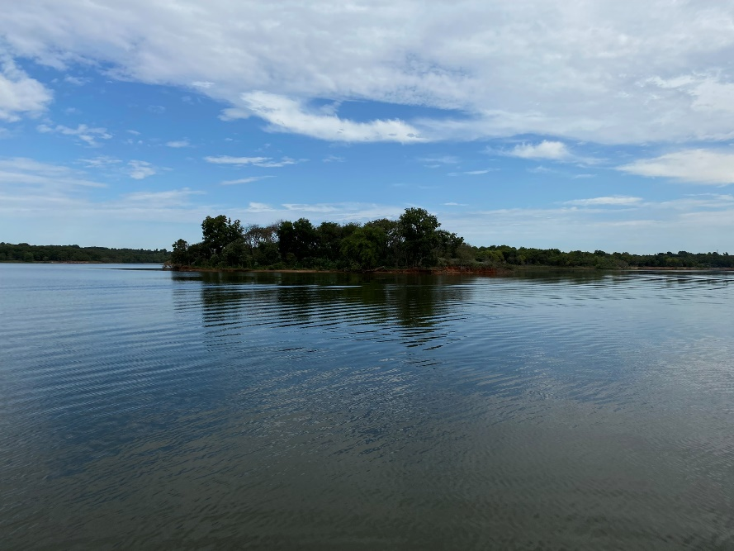
QUESTIONS?

Slide 18
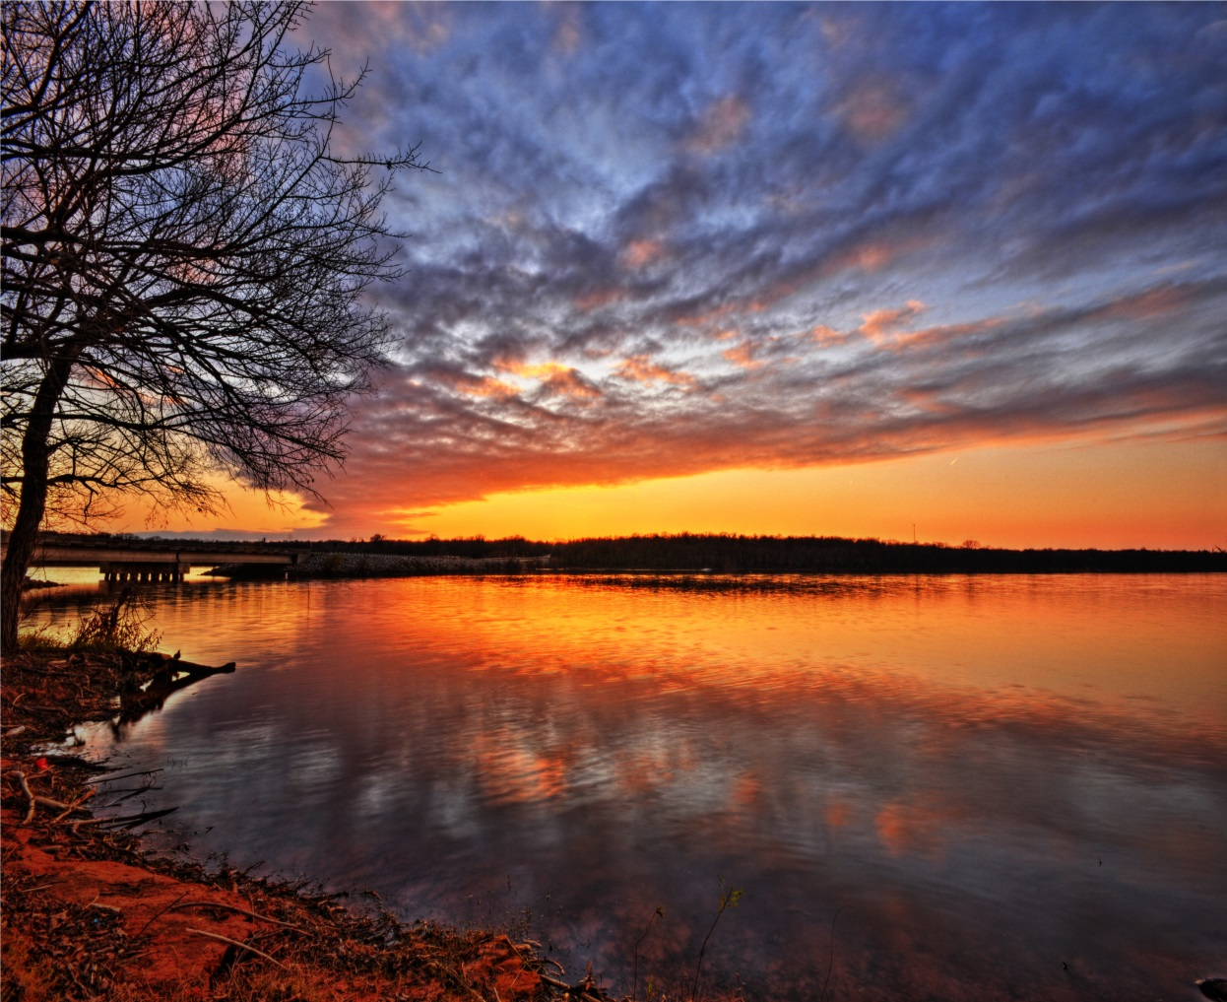
Thank You
SDOX

