Slide 1
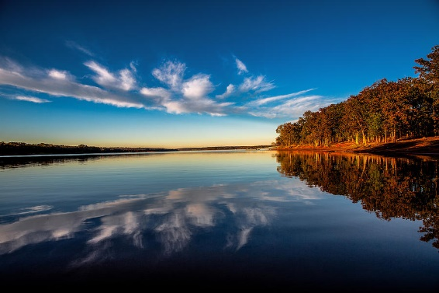
Lake Thunderbird 2021 Water Quality
Curt Dikes
May 5th, 2022

Slide 2
Outline
Watershed Update
2021 Climate Abnormalities
Water Quality Results
  Chlorophyll a
  Phosphorous
  Nitrogen
  Oklahoma Water Quality Standards

Slide 3
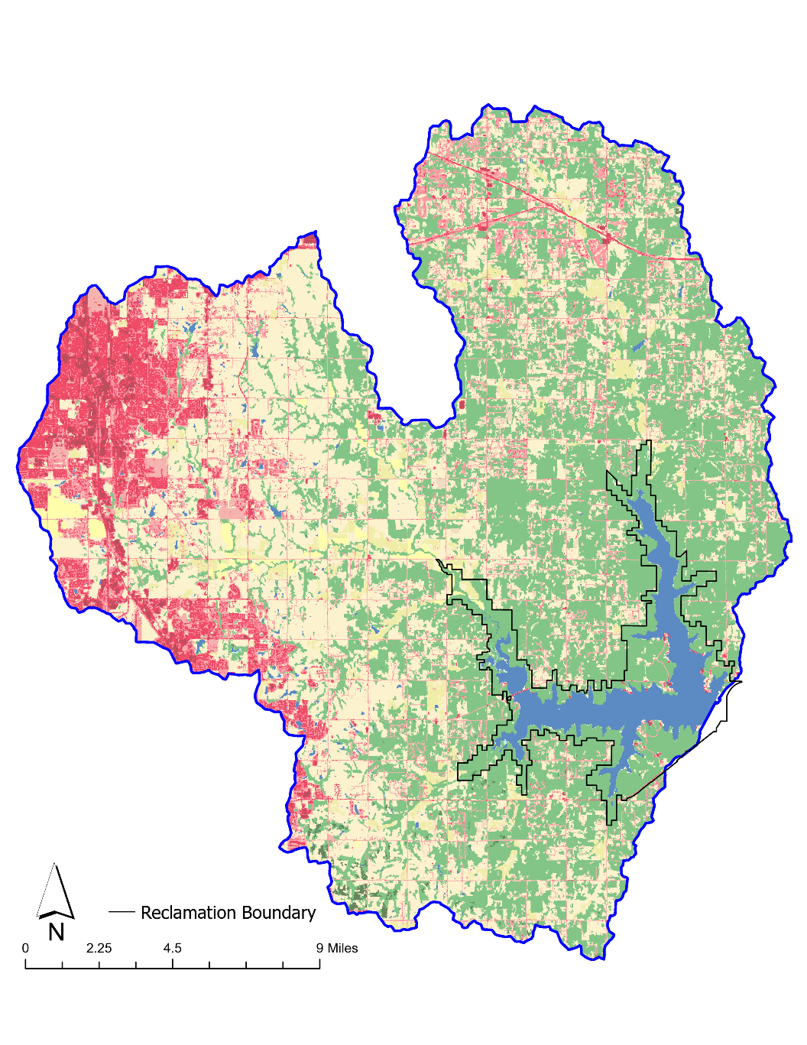
Thunderbird Watershed
2019 National Land Cover Data
Removal of Lake Stanley Draper
245 mi²
3.95% increase in developed cover 2016-2019

Slide 4
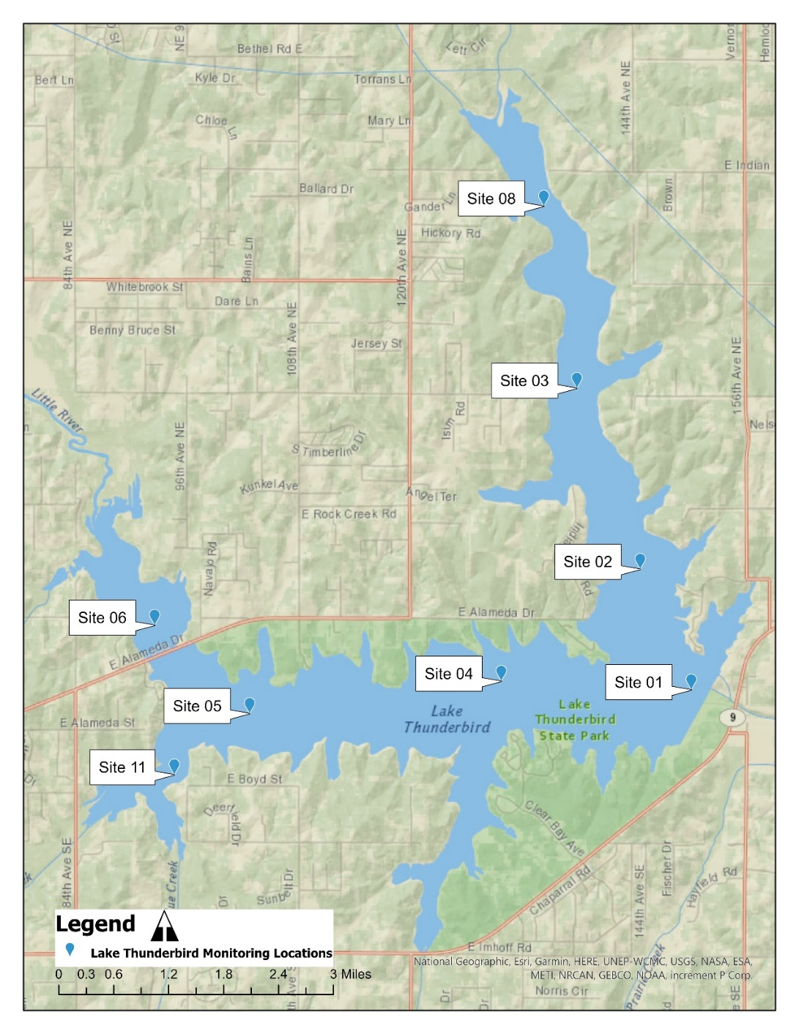
Lacustrine Sites
  Sites 1, 2, 4
Transitional Sites
  Sites 3 & 5
Riverine Zone
  Site 6 – Little River
  Site 8 – Hog Creek
  Site 11 – Dave Blue
Chlorophyll a
  All sites
Nutrients
  Sites 1 & All Riverine
Notes:
Site 4 –intake is 1016’ – 1023.1’
Water clarity, Secchi (200-230 mm), Turbidity

Slide 5




2021 Climate Abnormalities
Thunderbird Averages
38 inches of rain at dam (USACE)
1039.00’ normal pool
Tau 3.38
  1994-current
Below average precipitation – 25.25 inches
Massive hailstorms in spring
Wild swing in lake elevation observed
1037.9’-1043.9’
Largest gated release since 2019
Tau of 1.00

Slide 6
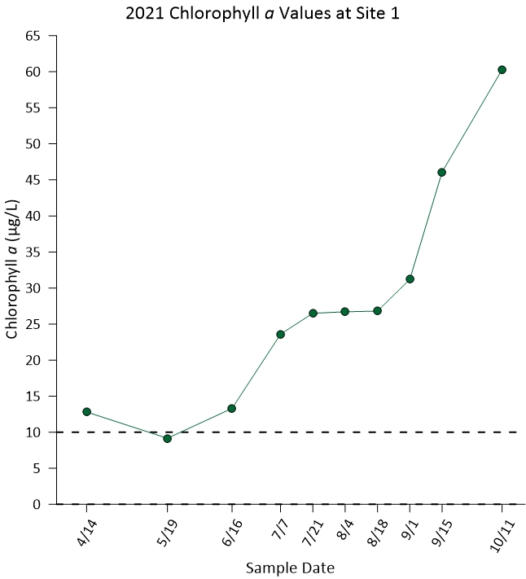
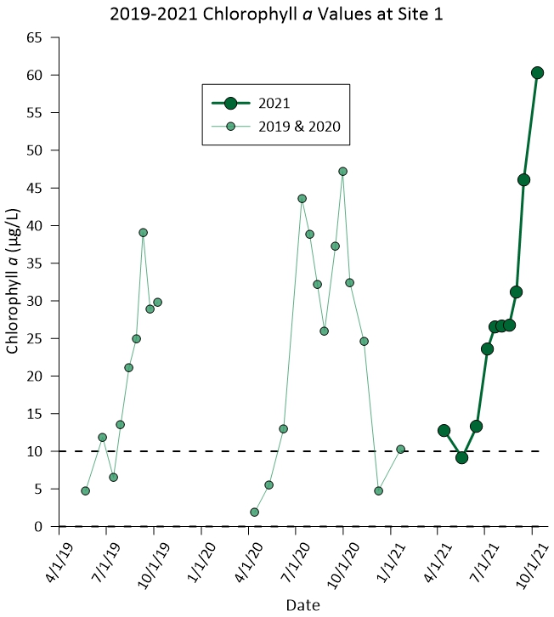
Chlorophyll a
Chlorophyll a
  Overall increased
  Started season high
  33.45 µg/L, more than 3x SWS criteria, 10 µg/L
    Highest since 2011
Notes:
Add Animation click
2 graphics

Slide 7
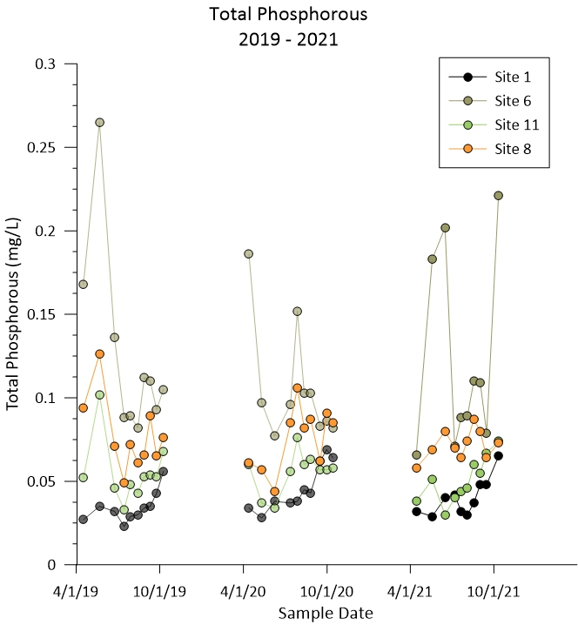
Phosphorous
Total Phosphorus
Maintain with previous reports
Higher than optimal to curb excess biological activity
Notes:
EPA – 0.05mg/L in lakes considered critical level

Slide 8
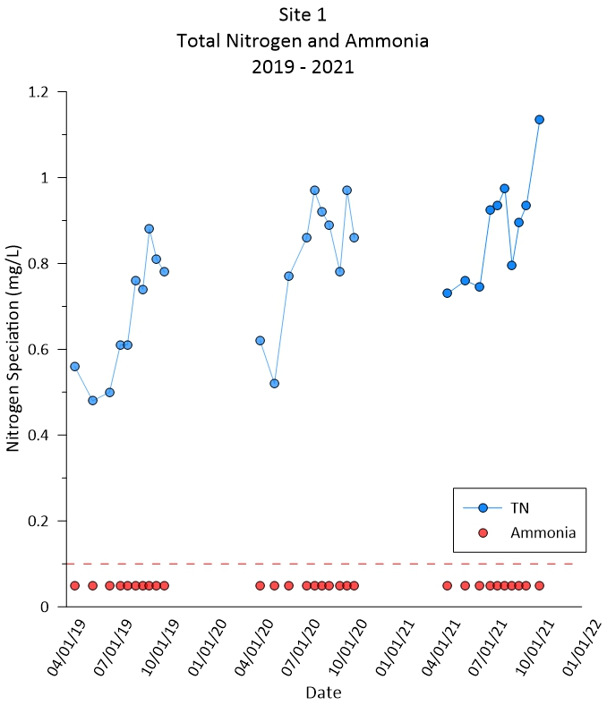
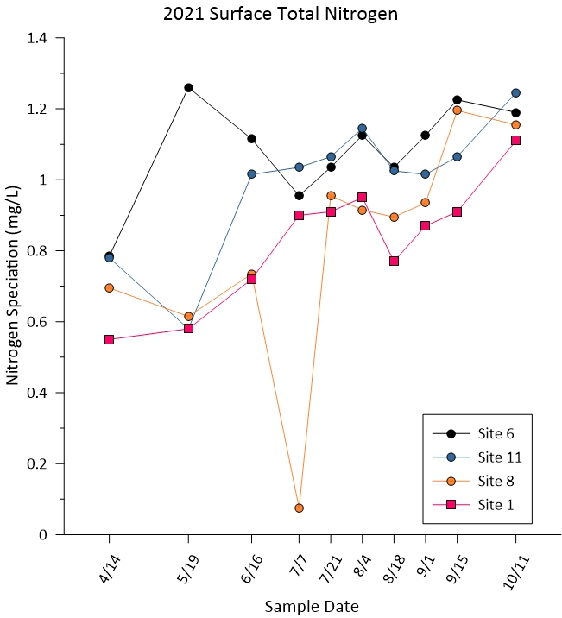

Nitrogen
Total Nitrogen
  Year over year increase at Site 1
Site 8 on July 7th
Notes:
2 graphics

Slide 9
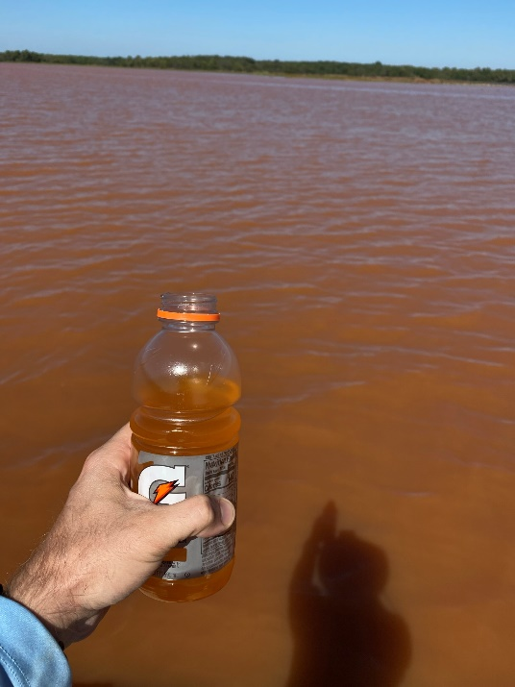
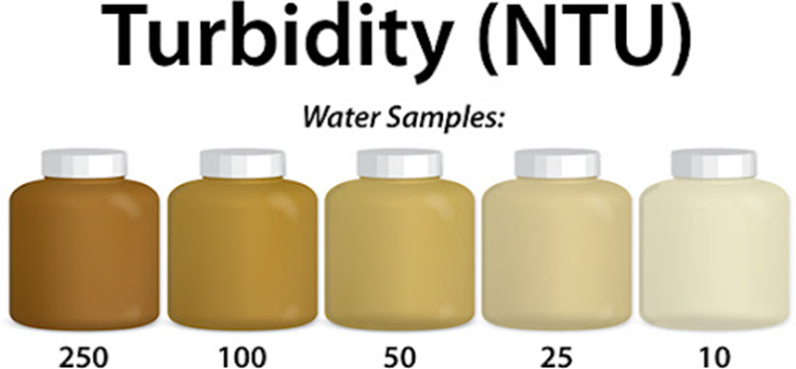
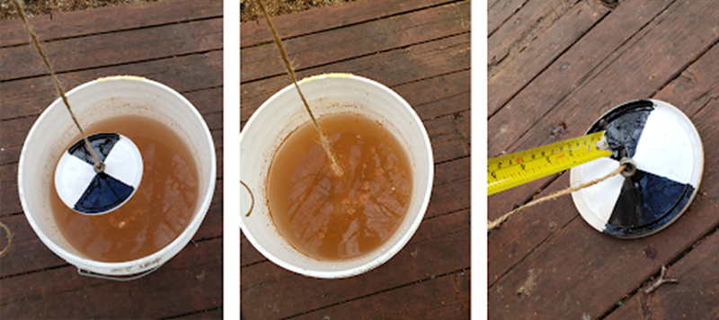
Turbidity
Turbidity
  Slight improvement
    19.10 NTU vs 20.01 in 2020
Fails to meet based on 10yr avg
Notes:
Site 6, May 2021 - 123ntu
Nephelometric (neff-elo-metric)

Slide 10



Dissolved Oxygen
OWQS Surface DO:
  4.0 mg/L Summer
  5.0 mg/L Spring & Fall
OWQS Volumetric DO:
  <50 % of cumulative lake volume
Fully met for surface criteria!
Volumetric Criteria
Failed 49.13% in July
Overall, 78.8% oxygenated volume
2018 & 2019 also failed for volumetric

Slide 11
TL;DR
Watershed & 2019 NLCD
  Developed space +4%
Data collected in 2021 fails to meet OWQS criteria for chlorophyll a, turbidity, DO
  Chl a – Public and Private Water Supply
  Turbidity & DO – Fish & Wildlife Propagation

Slide 12
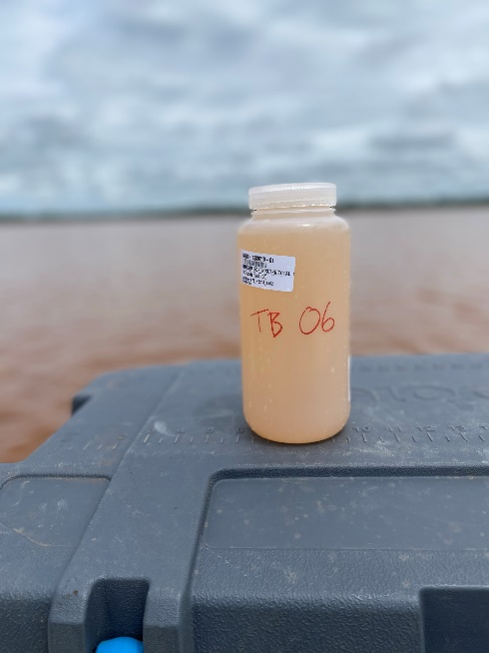
Recommendations
Nutrient sampling at all sites in 2022
Additional sampling events
Continue active leadership role within watershed
  Municipal meetings
  Watershed groups
  OTA turnpike planning
Notes:
Minimize data gaps

Slide 13
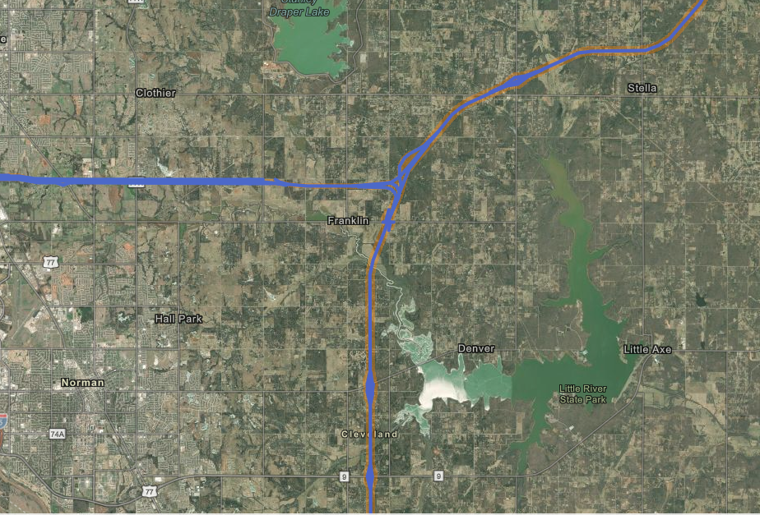

Slide 14
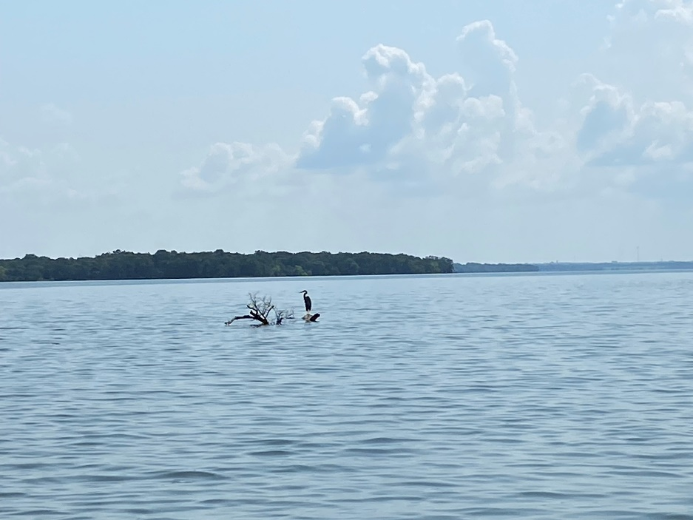
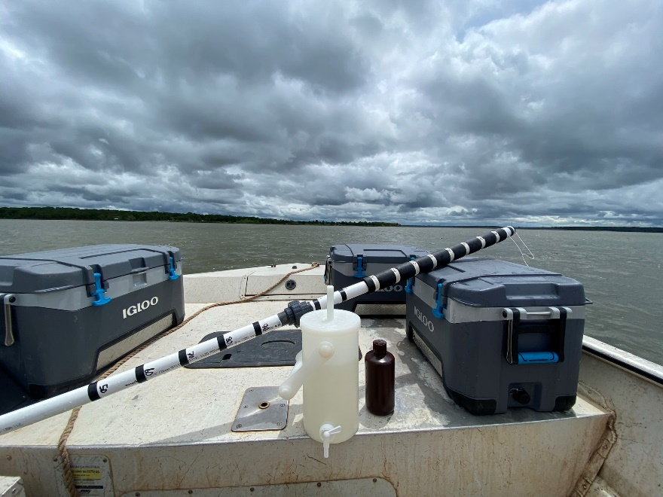
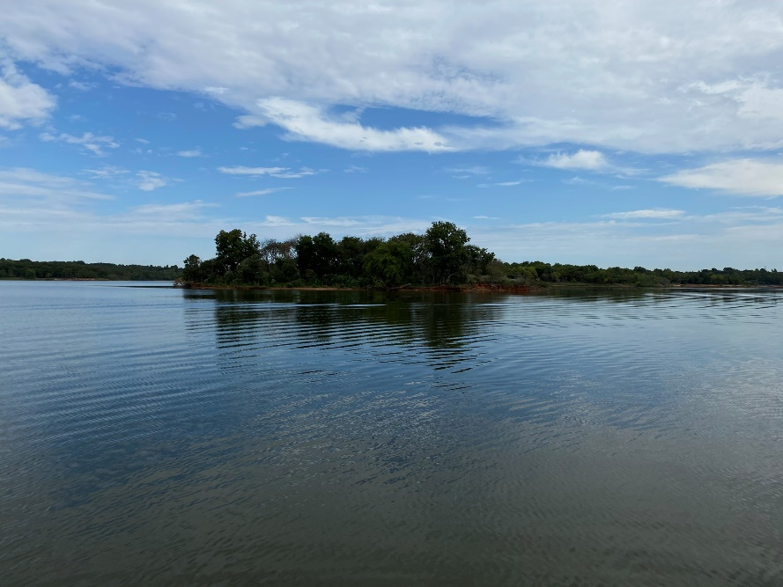
QUESTIONS?
Curt Dikes – Lakes Monitoring Specialist
  curt.dikes@owrb.ok.gov
  405.530.8929 office
  405.620.7219 cell

Slide 15
Internal Loading
Progress on all data generated from winter sampling
All samples have been analyzed
  In process of data wrangling
  Still a bit to go
Should be in good place by early summer for report generation
Notes:
Dr Thad Scott and Ashlynn Boedecker at Baylor University

Slide 16
Long-Term Trends
Working towards finalizing pieces for June presentation
Specific recommendations based on trends outcome
Presented as DRAFT until COMCD has opportunity to review and provide comment
Monty Porter will present remote and provide a single page summary
Notes:
Jet for data dashboard

Slide 17
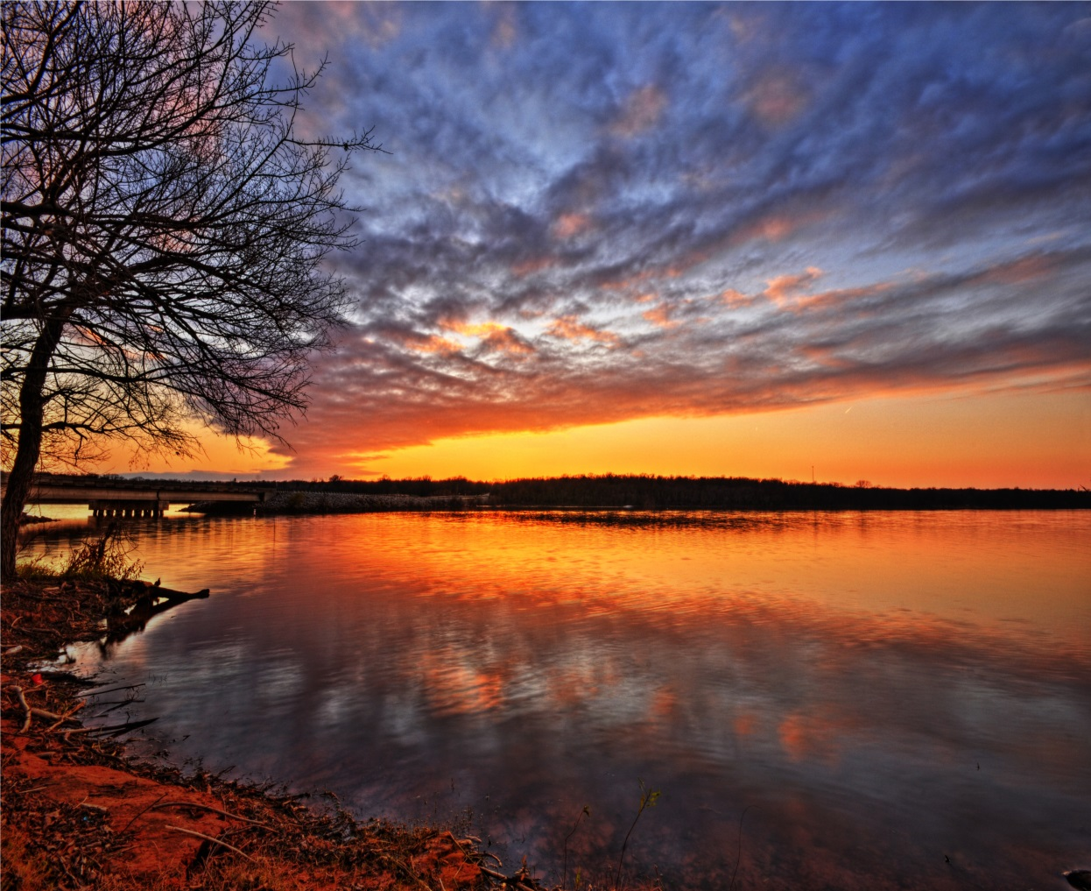
Thank You
SDOX

